Slide 1
A Wellness Challenge to Jains
May 15th, 2017– June 14th, 2017
Manu Shah
April 23rd, 2017

Slide 2
Sugar Free Living
Why?
5th Anniversary of 2012 Jain Center Wellness Challenge
What groundbreaking study found?

Slide 3
Wellness
The quality or state of being healthy in body and mind, especially as the result of deliberate effort.
An approach to healthcare that emphasizes preventing illness and prolonging life, as opposed to emphasizing treating diseases.

Slide 4
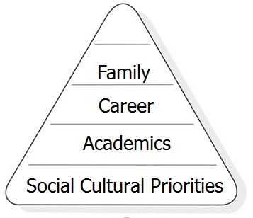
Why Us?
South Asians have inherited genes with high risk of diseases
Poor diet
Bad lifestyle choices
Nutrition?
Physical Activity?

Slide 5
GRANDPARENTS
PARENTS
25 – 45 years age group
CHILDREN
Pass the gene
to the next generation
Take the challenge
Improve health
Make the difference
Notes:
Sarva Mangal

Slide 6
The Problem - Heart
Incidence of Heart Disease is 4 times greater in South Asians compared to Caucasians.
50% of South Asians with Heart Disease are under the age of 50.
Notes:
Doctor

Slide 7
The Problem - Diabetes
Every third diabetic in the world is Indian
Risk of Type 2 diabetes is four times higher in Indians
Nearly half of Indians have Central Obesity

Slide 8
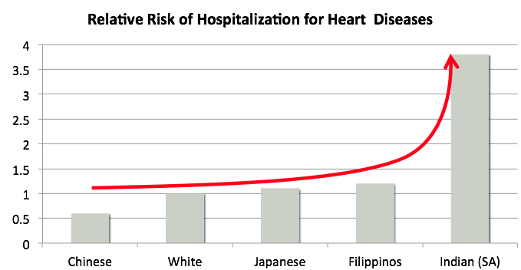
Risk of Hospitalization
Kaiser Permanente, a large health maintenance organization (HMO) in the US, found an alarmingly high rate of hospitalization for heart disease among its Indian patients in Northern California.
The risk of hospitalization for heart diseases if about 4 times higher than Caucasian patients and 6 times higher than Chinese patients.
About one half of Indian men who have a heart attack are 50 years old or younger, and one quarter are 40 or younger.
Notes:
Doctor

Slide 9
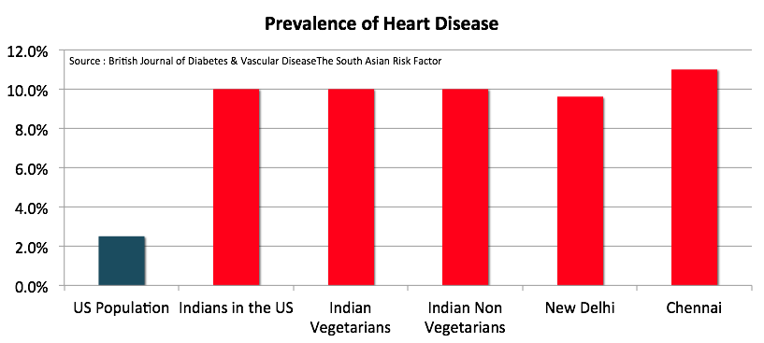
Prevalence of Heart Disease
Indians have a 50-400% higher rate of heart disease and diabetes than other populations, regardless of geographic location.
Vegetarian Indians have a similar rate of heart disease and diabetes as non-vegetarians.
Heart disease and diabetes occur in Indians who have a normal BMI.
In a study of Indian doctors, one in ten had documented heart disease.
Notes:
Doctor

Slide 10
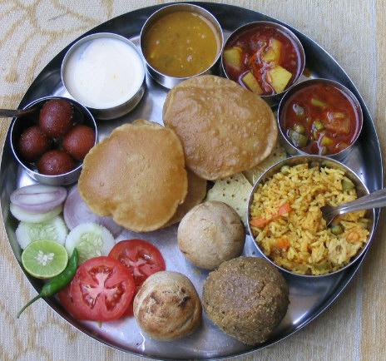
Why Us?
Diet
Refined carbohydrates
Saturated fats
Fried Puri
High calorie intake
High Saturated Fats
No fruits and minimal vegetables

Slide 11
Traditional Risk Factors for Heart Disease and Type 2 Diabetes
Traditional risk factors for heart disease include:
Smoking
Obesity
High blood pressure
High total cholesterol
Low physical activity
Low high-density lipoprotein (HDL) cholesterol
Pre-diabetes
Traditional risk factors for type 2 diabetes include:
Obesity
A sedentary lifestyle
A sugar-heavy diet
High blood pressure
Pre-diabetes
Notes:
Doctor

Slide 12
HEALTH ASSESSMENTS
62%
OVERWEIGHT
48% AT RISK
OF HEART DISEASE
42% PRE-DIABETIC
15% DIABETIC
2012 Study at JCSC

Slide 13
What Did We Learn…
Habit of generations are not easy to change
Richest Minority- Highest Educated
Most Medical professionals per capita
Jains
wellness score is similar to bottom 30% of Americans
Giving up should not be the choice

Slide 14
Jain Center of Southern California
Wellness Committee
2017 Challenge
Jain Center
Notes:
Should be on while introducing the Speakers.

Slide 15
Sugar Free
No Refined Sugar (White or Brown), No Artificial Sweeteners
No Soda – Diet Soda
Details to follow
Take the “Sugar Free Living” Wellness Challenge
May 15th or June 14th (Age 18 & Up)
Sarva Mangal Family Trust Will Donate $100 per participant to the Jain Center Wellness Program For Those Successfully Completing Sugar – Free Month

Slide 16
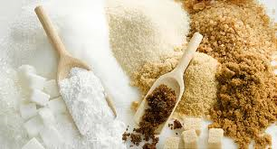
Sugar
Quick Energy
Or
Slow Poison
Choose Your Portion
Wisely!
Ban Refined Sugar for One Month at
Jain Center

Slide 17
Sugar is the World’s Most Popular Drug!
Sugar induces the same responses in the region of the brain known as the ‘reward center’ as nicotine, cocaine, heroin, and alcohol.
Sugar and sweets have become the tools we wield to reward our children’s accomplishments, to demonstrate our love and pride in them, to motivate them, to entice them.
Sugar can trigger rapid changes in respiration, heartbeat, skin color and so on.
Sugar appears to cause pleasure with a price that is difficult to discern immediately and paid in full only years or decades later

Slide 19
Great Economic Reasons
Strong Correlation Over-weight to Diabetes
Health Insurance – Pre-existing Conditions – Obamacare vs New Plan under Trump
Term Life Insurance 35 Years Men(5’-9”) - over weight by 25% - Double the premium
Term Life Insurance 35 Years Women(5’-4”) - over weight by 25% - Triple the premium
Whole Life Policy Type 2 Diabetics A1C >6.6 to 7.1< 30% More rate based on Age
Whole Life Policy Type 2 Diabetics A1C >7.1 100% More rate or uninsurable based on Age
Heart Problem to Heart attack 50% more to Uninsurable
The price of obesity: How your salary depends on your weight
Men 5 to 20% less Women 10 to 30% less Normal, Over weight, Over weight
Time to Finding Job 30% to 300% longer depending on unemployment rate

Slide 20
Jain Center of Southern California
Join
Participants
Volunteers
Promoters
Sponsors
Well-wishers
Notes:
Should be on while introducing the Speakers.

